Slide 1
Exercising Opportunities for Control in
International Arbitration
Professor Christopher Gibson
July 8, 2020

Slide 2



Exercising Opportunities for Control in
International Arbitration
Christopher Gibson
Professor of Law and Director
Business Law and Financial Services Concentration
Suffolk University Law School
Arbitrator and Mediator
Boston

Slide 3
Agenda
Context for transactions and dispute resolution:
  Where we’re at “risk” has not gone away
Extend transactional mindset / skills into dispute resolution
Dispute resolution design – arbitration features tailored to parties’ need
Hypo: Dispute between two life sciences companies

Slide 4

Dispute Resolution – Opportunity to Exercise “Practical and Fair Control”
“Control your own destiny or someone else will.”
Jack Welch, former CEO
Business context: “control” is important for minimizing and allocating risks
Bring that perspective to dispute resolution
Dispute resolution: exercise “control” – practical and fair control – through choices parties make to resolve complex international disputes
  Extension of parties’ exercise of post-deal business cooperation

Slide 5

Globalization 3.0
  “the real information revolution is about to begin. I call this new phase Globalization 3.0”
  “this new era of globalization will prove to be such a difference of degree that it will be seen, in time, as a difference in kind. That is why I introduced the idea that the world has gone from round to flat.”
The World is Flat – a Brief History of the 21st Century
Thomas Friedman (2007)
    Globalization 1.0 – circa 1492 to 1800
      religion, military power
    Globalization 2.0 – circa 1800 to 2000
      economic, transportation, communications

Slide 6
Flat-World Political Science 101
The Dell Theory of Conflict Prevention
“No two countries that are both part of a major global supply chain, like Dell’s, will ever fight a war against each other as long as they are both part of the same global supply chain….”
Thomas Friedman, The World is Flat

Slide 7

Risks
    Changes in law or government
    Environmental risks
    Disease risks
    Performance interruption
    Political risk
    Cyber risks
    Terrorism risks
Exogenous - risks relating to external factors
Endogenous – risks originating between parties
    Financial risks
    Technology risks
    Breach

Slide 8
Extension of Transactional Skills into Dispute Resolution
Risks require managing in every business transaction
Helping clients identify / manage risks is essential function of business lawyers
  Ask “what if”
Value not just in identifying all possible risks, but identifying most significant risks
  Advise clients on
  (i) probabilities associated with particular risk, and
  (ii) consequences – allows client to better price risk and decide how to address it
Extend this mind-set into dispute resolution
Golden Rule:
Maximize value while
minimizing risk

Slide 9
US Supreme Court
“A contractual provision specifying in advance the forum in which disputes shall be litigated and the law to be applied is…an almost indispensable precondition to achievement of the orderliness and predictability essential to any international business transaction.”
    Aware of “sensitivity to the needs of the international commercial system for predictability in the resolution of disputes.”
    By agreeing to arbitrate statutory claim, party does not forgo substantive rights and instead “trades the procedures and opportunity for review of the courtroom for the simplicity, informality, and expedition of arbitration”
Scherk v Alberto-Culver Co., 417 U.S. 506 (1974)
Mitsubishi Motors v. Soler, 473 U.S. 614 (1985)

Slide 10
Federal First Circuit (Boston, Northeast, Puerto Rico)
“national policy favoring arbitration has extra force when international arbitration is at issue.”
“In keeping with this policy [in favor of arbitration], and in honoring the forum that has been contractually chosen by the parties to resolve their disputes, review of arbitration decisions by the courts is extremely narrow and exceedingly deferential.”
Sourcing Unlimited v. Asimco Int'l
526 F.3d 38 (1st Cir. 2008)
First State Ins. v. Banco de Seguros Del Estado 254 F.3d 354 (1st Cir. 2001)

Slide 11
Arbitration and the Courts
  “Ideally, the handling of arbitral disputes should resemble a relay race.
  In the initial stages, before the arbitrators are seized of the dispute, the baton is in the grasp of the court; for at that stage there is no other organisation which could take steps to prevent the arbitration agreement from being ineffectual.
  When the arbitrators take charge they take over the baton and retain it until they have made an award.
  At this point, having no longer a function to fulfil, the arbitrators hand back the baton so that the court can, in case of need, lend its coercive powers to the enforcement of the award.”
Lord Mustill, “Comments and Conclusions in Conservatory
Provisional Measures in International Arbitration”,
9th Joint Colloquium (ICC Publication 1993)

Slide 12
Dispute Resolution Design - Arbitration
Major providers have developed innovations available to parties:
  Expedited / stream-lined procedures
  Emergency arbitrators / arbitrations
  Streamlined three-arbitrator panel option
  Rules controlling production of documentary evidence / discovery
  Case management techniques
  Confidentiality (except as necessary in enforcement of award, or as required by law)
  Limit in-person hearings (or decision on documents alone)
  Flat fees in small cases
  Diversity in panelists

Slide 13

Advice to corporate/commercial lawyers?
Two key moments/points to address possibilities
  Arbitration clause
  First prehearing conference
Look at every transaction from perspective of what happens if dispute arises
  Time for dealing with possibility of dispute is at outset of relationship, not after dispute erupts
Fundamentals:
  choice of forum
  choice of law
  choice of dispute settlement procedures
    negotiation → mediation
Consider more detailed provisions
arbitration
court litigation

Slide 14
Arbitration clause
Any dispute, controversy, or claim arising out of or in connection with this contract, or the breach, termination or validity thereof, shall be submitted to the Chartered Institute of Arbitrators (CIArb) and settled by final and binding arbitration in accordance with the CIArb Arbitration Rules. Judgment on any award issued under this provision may be entered by any court of competent jurisdiction.
Appointment of arbitrator
The arbitral tribunal shall be composed of [one or three] arbitrator(s).
2. Place of arbitration and applicable procedural law
The place of arbitration shall be [choose city and country]. The proceedings shall be conducted in accordance with the arbitration law of the place of the arbitration.
3. Language of arbitration
The language(s) of the arbitration proceedings shall be [choose language(s)].
4. Law governing contract and arbitration agreement
The contract shall be governed by the substantive law of [choose country], exclusive of any conflict-of laws rules that could require the application of any other law.
The arbitration agreement shall be governed by [choose relevant law].

Slide 15
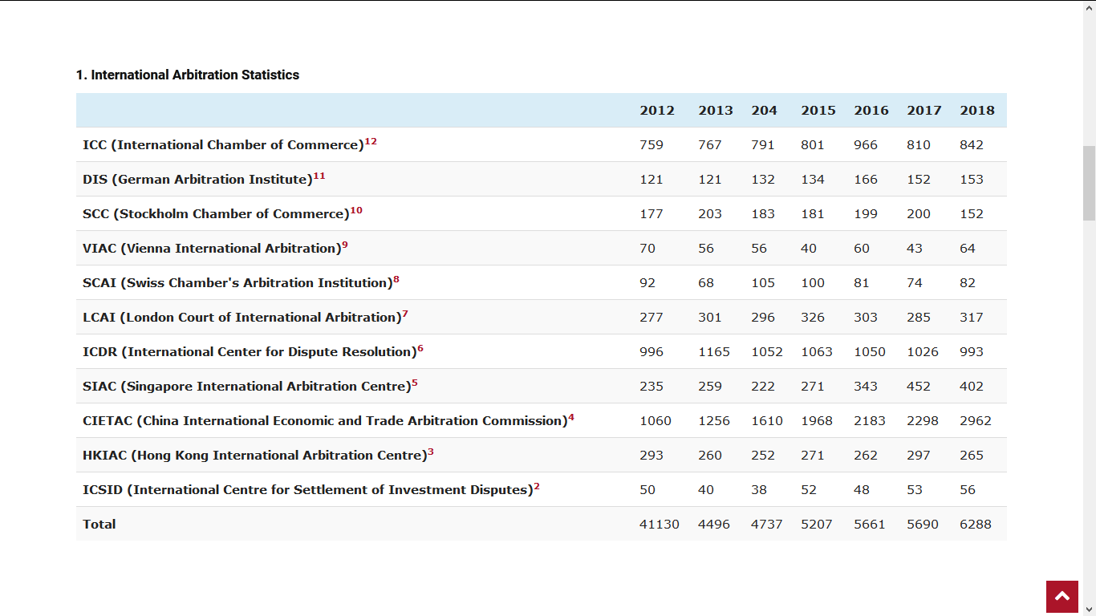
4130
6288
* Global Arbitration News (GAR), International Arbitration Statistics 2018 Dr. Markus Altenkirch and Malika Boussihmad, July 2, 2019

Slide 16
Arbitration features
Why choose international arbitration?
  Certainty of single, central forum
  Neutral forum
  Parties participate in choice of arbitrator(s) → arbitrator expertise
  Arbitration is consensual → enables party autonomy
  Measure of control over procedures in conduct of proceeding
  Cost-effective / efficient / flexible
  Private & confidential
  Award is final, binding & enforceable internationally under New York Convention
Which of these is often considered most important?

Slide 17
Hypo: Dispute Between Life Sciences Companies
Pharma A
Licensor
Pharma B
Licensee
R&D license for
patented research tools
Claims
  Breach of license agreement / infringement
  Invalidity of patents
Facts
  R& D license for patented biotechnology used by Pharma B in several countries
  Multiple patents in US and worldwide
  Pharma B developing new therapeutic drug
  Clinical trials around world, moves through FDA’s NDA process
  After making milestone payments, Pharma B withholds royalties (derived from sales of new drug)

Slide 18
Arbitrability of Patent Disputes
35 US Code § 294. Voluntary arbitration
(a) A contract involving a patent or any right under a patent may contain a provision requiring arbitration of any dispute relating to patent validity or infringement arising under the contract…. Any such provision or agreement shall be valid, irrevocable, and enforceable, except for any grounds that exist at law or in equity for revocation of a contract.
(c) An award by an arbitrator shall be final and binding between the parties to the arbitration but shall have no force or effect on any other person.

Slide 19
License Agreement
License Agreement – extremely important contract in modern conceptual economy – over $110 billion annually to patent owners
R& D license (“reach-through license agreement”)
  reach-through license provides royalties to licensor (developer of patented research tool) based on sales of products that are developed through use of tool – even though research tool is not incorporated in final product (e.g., new therapeutic drug)
  debate on both sides regarding validity of this form of license extending payments potentially beyond patent term; unduly limits right to creatively negotiate financial terms in license agreement? Royalty stacking?
  Kimble v. Marvel Entm’t, LLC, 135 S. Ct. 2401 (2015)
  Brulotte v. Thys. Co, 85 S. Ct. 176 (1964) - held: patentee cannot continue to receive royalty payments after patent has expired

Slide 20
Patentability – 35 USC §101 (patent eligible subject matter)
  Sea-change in US patent law since 2012 – laws of nature, natural phenomena, and abstract ideas not patentable
    Mayo Collaborative (2012); Alice Corp (2014)
  Patent eligibility under 35 USC §101 is two-step process:
    identify whether claims are directed to patent ineligible subject matter
    if so, is there still “inventive concept” apart from law of nature that transforms claim into patent-eligible
  Athena Diagnostics (Fed. Cir. 2019)
    appeal from US District Court (Mass) holding patent claims invalid – claims covered methods for diagnosing neurological disorders by detecting antibodies to specific protein
    Affirmed: district court correctly concluded claims are directed to natural law and lack inventive concept

Slide 21
Hypo: Dispute Between Life Sciences Companies
Pharma A
Licensor
Pharma B
Licensee
Design of Arbitration
  Institutional or ad hoc – choose rules or ad hoc arbitration with appointing authority [CIArb / CPR / ICDR / ICC / WIPO / other]
  Confirm legal seat of arbitration – arbitrability
  Choose tribunal with expertise
  Neither party identified as claimant or respondent – burden of proof on any element dependent on party asserting that claim or defense
  Parties and tribunal members sign confidentiality agreement
  Express: award is final, binding, non-reviewable and non-appealable, enforceable in court of competent jurisdiction

Slide 22
Applicable law and Phased Approach
Applicable law – dépeçage (different issues governed by laws of different states)
  Massachusetts, New York, California, Delaware, English law
  Patent law in various jurisdictions
Use “reference countries" – e.g., United States for activities conducted in United States, and [United Kingdom / Germany/ Switzerland] for activities conducted outside United States
Break arbitration into phases – bifurcation (or trifurcation)
  Validity of license agreement and interpretation of key provisions
  whether Pharma B “practiced” patents in various jurisdictions
  validity of patents in jurisdictions where patent is practiced

Slide 23
Two key moments/points to address possibilities
Arbitration clause
First prehearing conference
CIArb Arbitration Rules (2015)
  designed for domestic and international ad hoc arbitrations
Article 17 — General provisions
1. Subject to these Rules, the arbitral tribunal may conduct the arbitration in such manner as it considers appropriate, provided that the parties are treated with equality and that at an appropriate stage of the proceedings each party is given a reasonable opportunity of presenting its case….

Slide 24
Hypo: Dispute Between Life Sciences Companies
Pharma A
Licensor
Pharma B
Licensee
Procedural order – à la “terms of reference”
Confirm:
  appointment of panel and waiver of objections
  legal seat of arbitration
  confidentiality
  chair permitted to manage arbitration on preliminary procedural issues / discovery issues – e.g., “Streamlined Three-Arbitrator Panel Option”
  phases & issues to be decided for each phase
  timeline – dates for discovery / experts / motions / hearing / interim award / award
  procedures for communications
  location / time allotments / court reporter

Slide 25
Hypo: Dispute Between Life Sciences Companies
Pharma A
Licensor
Pharma B
Licensee
Design of Arbitration
Adopt IBA Rules on Taking of Evidence in International Arbitration and/or limit discovery (e.g., depositions, interrogatories, requests for admissions, requests for production) except on issue of “practice”
Hearing – each party submits:
    proposed ruling on each issue, together with request for specific damage award or other remedy
    brief supporting party's proposed rulings and remedies (page limited)
    copies of all exhibits on which party relies
    list of witnesses / experts to be called and summary of testimony
    expert reports
    rebuttal memorials (page limited)
    time allocations for hearing

Slide 26
Summary – Incentives for Parties
Meets need for certainty / predictability of single forum for dispute resolution in relation to complex multi-jurisdictional business relationship
Better matches pace of business cycle – parties need answers
Designed to reach informed and reliable result
Expertise of tribunal
Confidentiality
Case management techniques permit procedural flexibility and scope to exercise fair and practical control during process
  – especially when compared to litigation
Phased approach / interim awards provides critical feedback to parties – increases prospect for settlement
Preempt Inter Partes Review (IPR) procedure (challenging patent validity) before PTAB?
Decision binding only inter partes
Arbitration truism? – “The process is only as good as the arbitrator(s) conducting it.”
Reality check: most clauses drafted by transactional / corporate lawyer, sometimes at last minute, without extending risk analysis into dispute resolution process.

Slide 27
Q & A Session
Thank You
Look for upcoming programs at https://www.ciarbnab.com/

